Slide 1




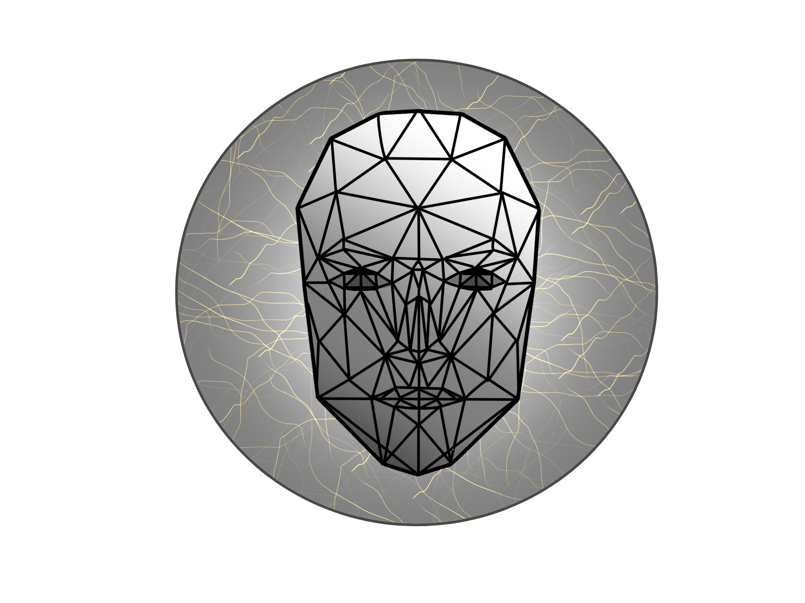

FACECODERS
Anna Preczyńska
Mariusz Pisarski
Michał Suliborski
Yurii Shcheoholiev
1
Notes:
Hello everybody! We are the “TEAM_NAME” and today we want to show you our story about the problem we have found. But first, let’s introduce ourselves. My name is Ania, this is Mariusz, Michał and Yura. We are four different personalities, with different interests, and we were connected only through the field of study, which is Information Technology. But now, it has changed.

Slide 2

2
Notes:
We are talking almost every day. Together, we are preparing for meetings and presentations. We discuss. A LOT. AND OFTEN. That’s why we needed to know how to reach compromises and talk with the biggest efficiency. Together we drank 26 coffees, eat 3 dinners and at least 12 times we did a really big brainstorm.

Slide 3
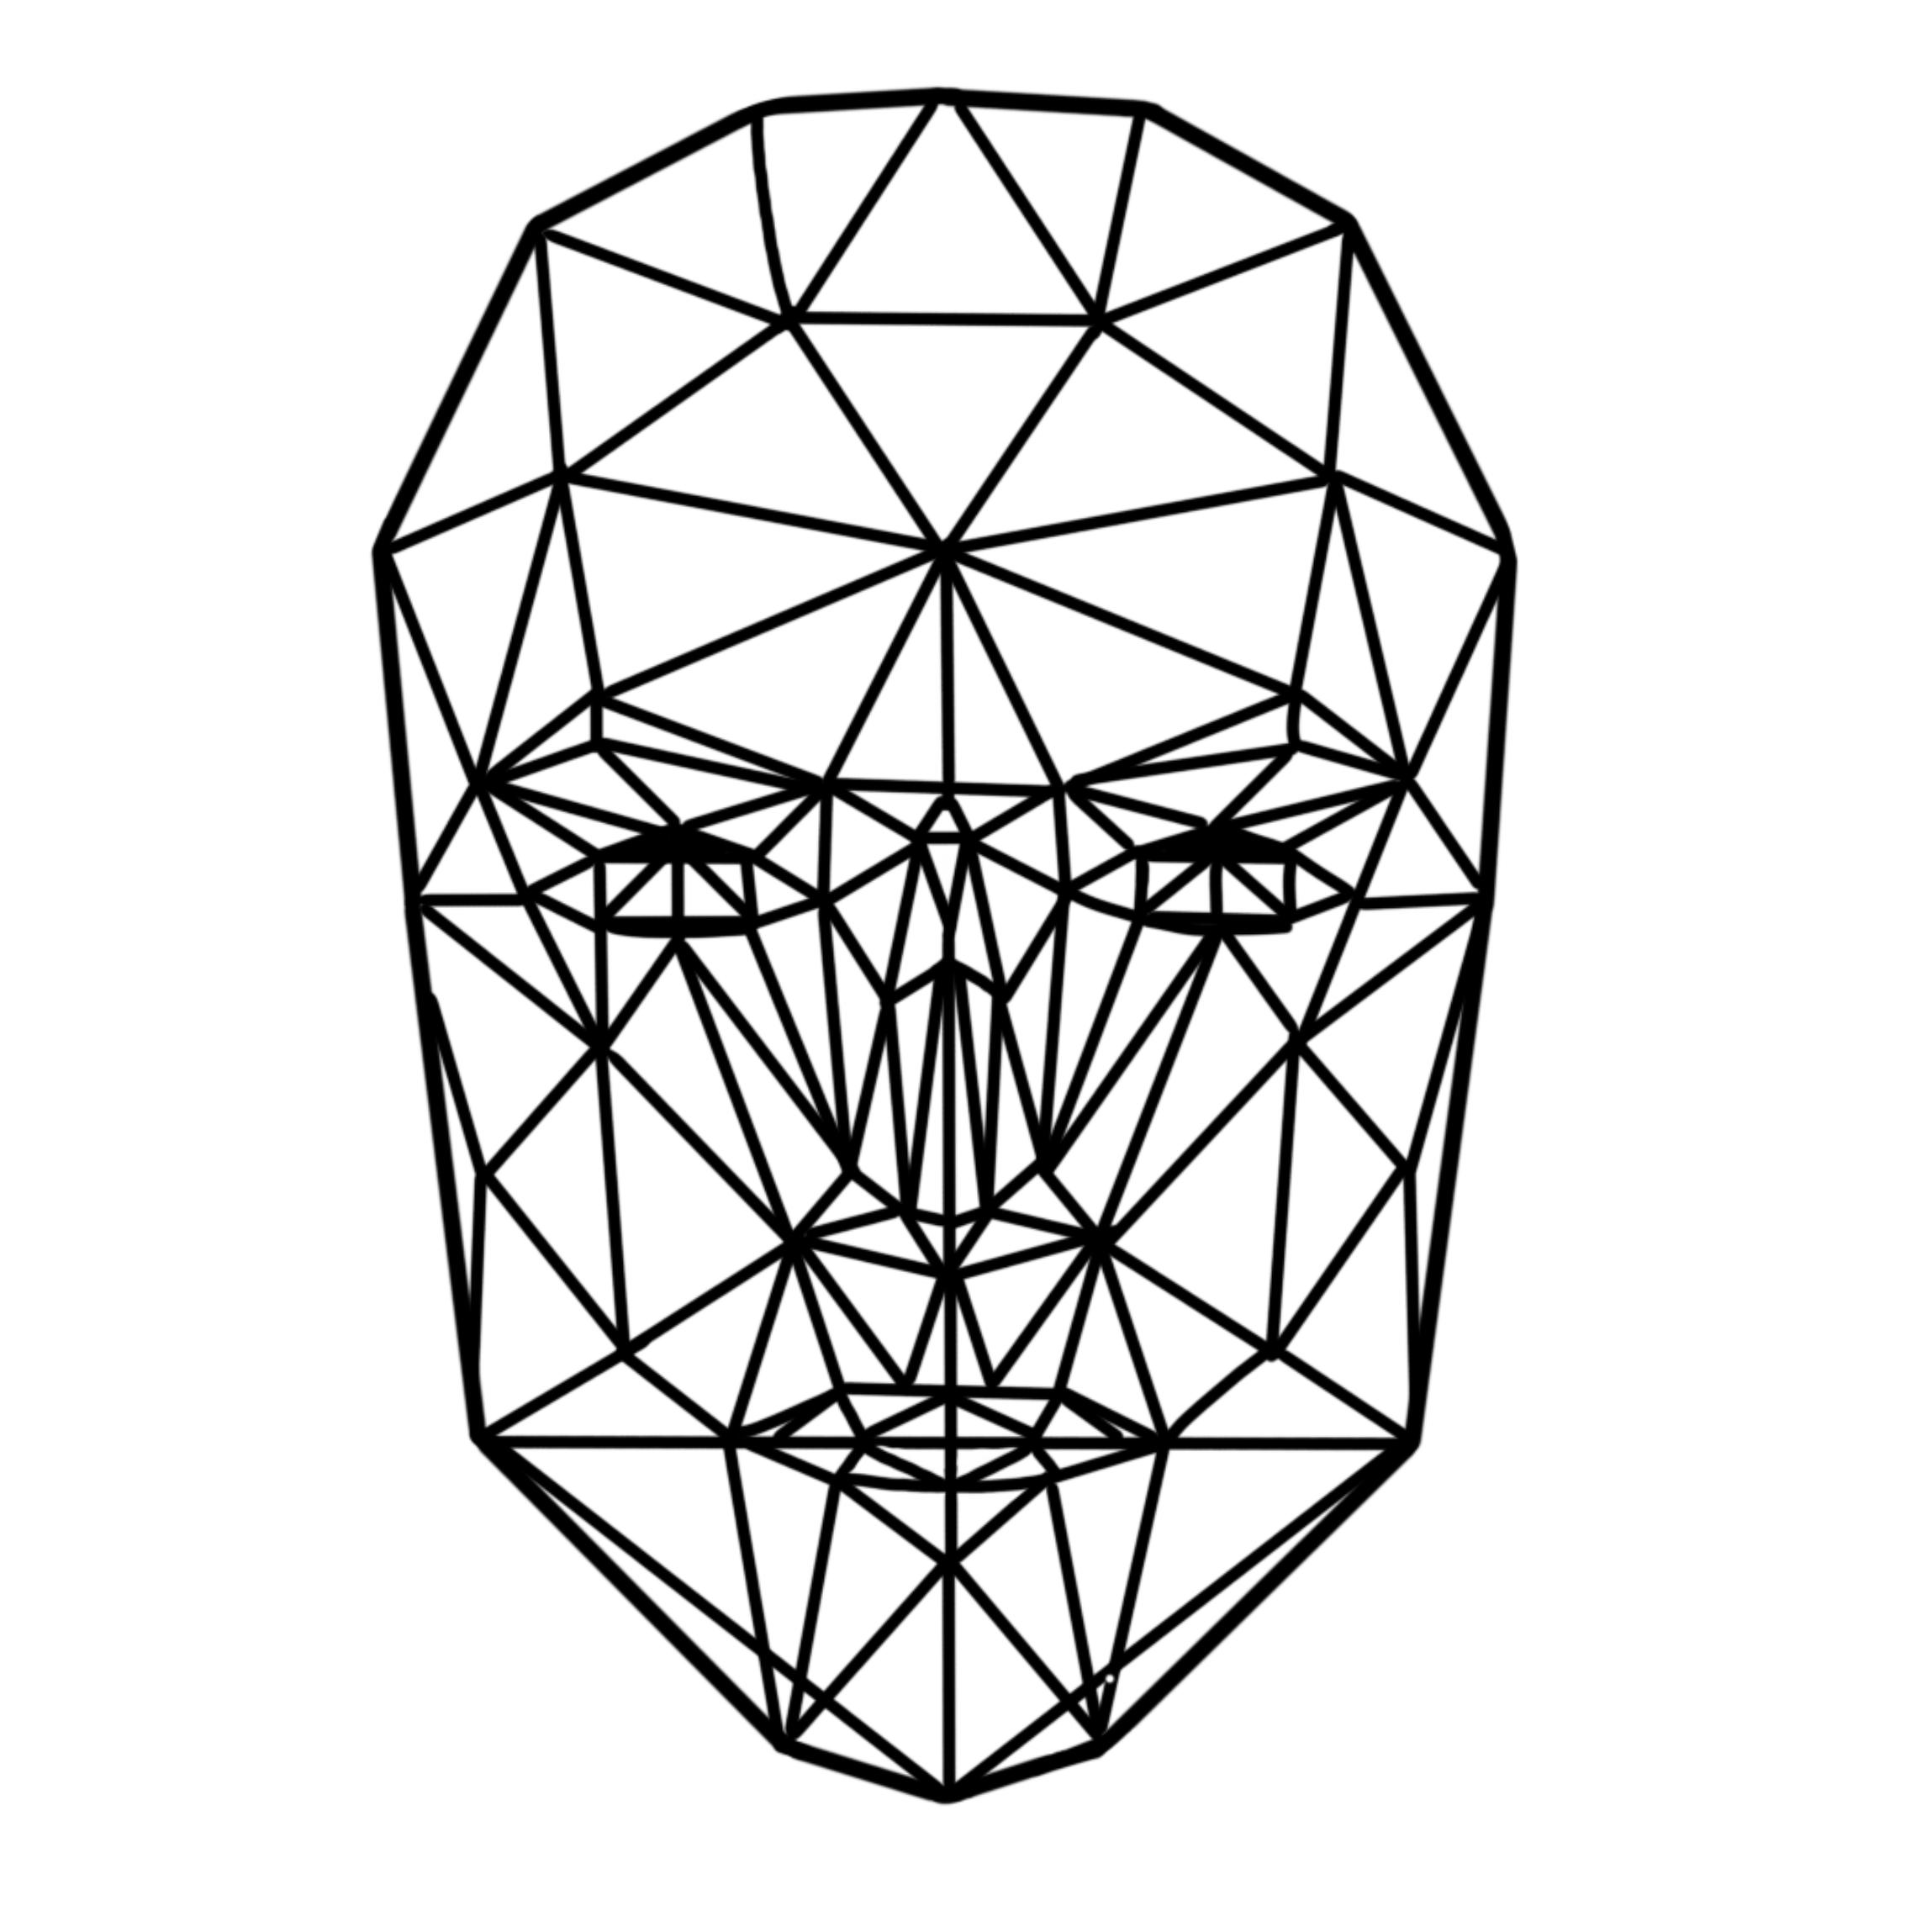
Affective computing and emotion detection
3
Notes:
Our topic is “Affecting computing and emotion detection”. According to our first researches we decided very early that our logo will be based on the Candide- the parametrized face, that is presented on the screen. It is commonly used to detect face on the picture. During further analysis of the varius candide changes, the emotion detection is possible.
//candide face model

Slide 4

EMOTIONS
4

Slide 5
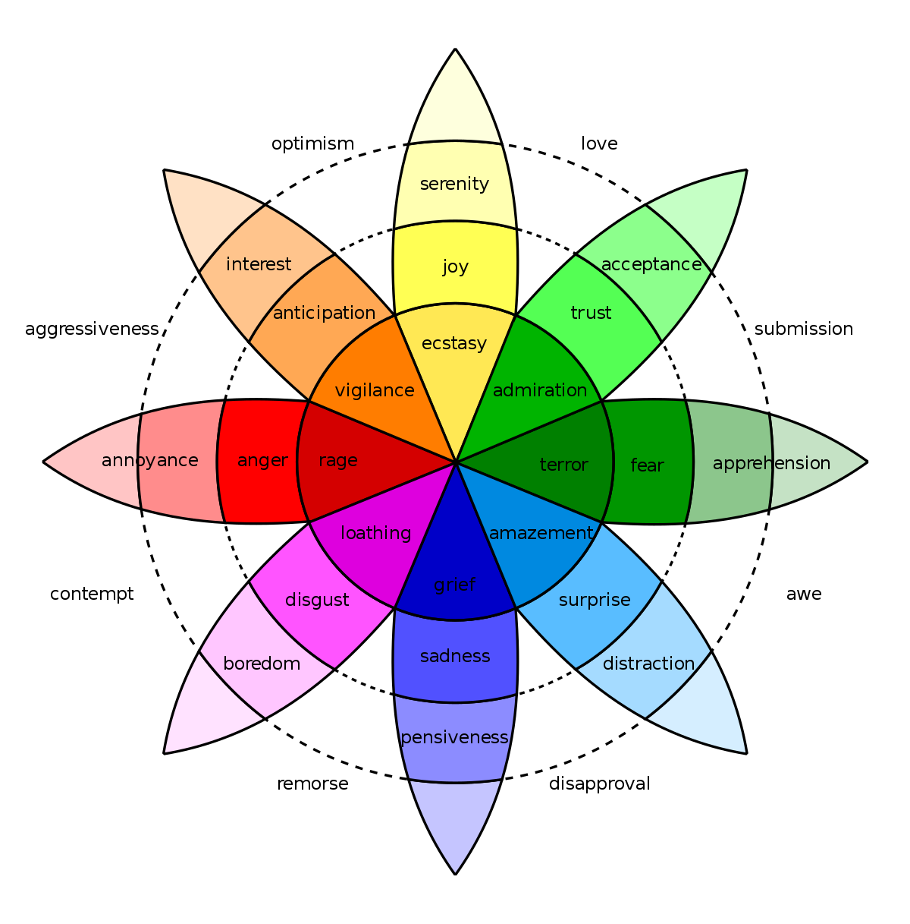
5

Slide 6


6
Notes:
As you already noticed, all of us may have problems in emotion recognition in some situations. However, let’s focus on the ones, who genetically have the problem with that. What about people with autism?

Slide 7

7
Notes:
Autism is a developmental disorder, characterised by difficulty with social interaction and communication. In most cases it concerns children. People with autism are unable to correctly read any stimuli.

Slide 8
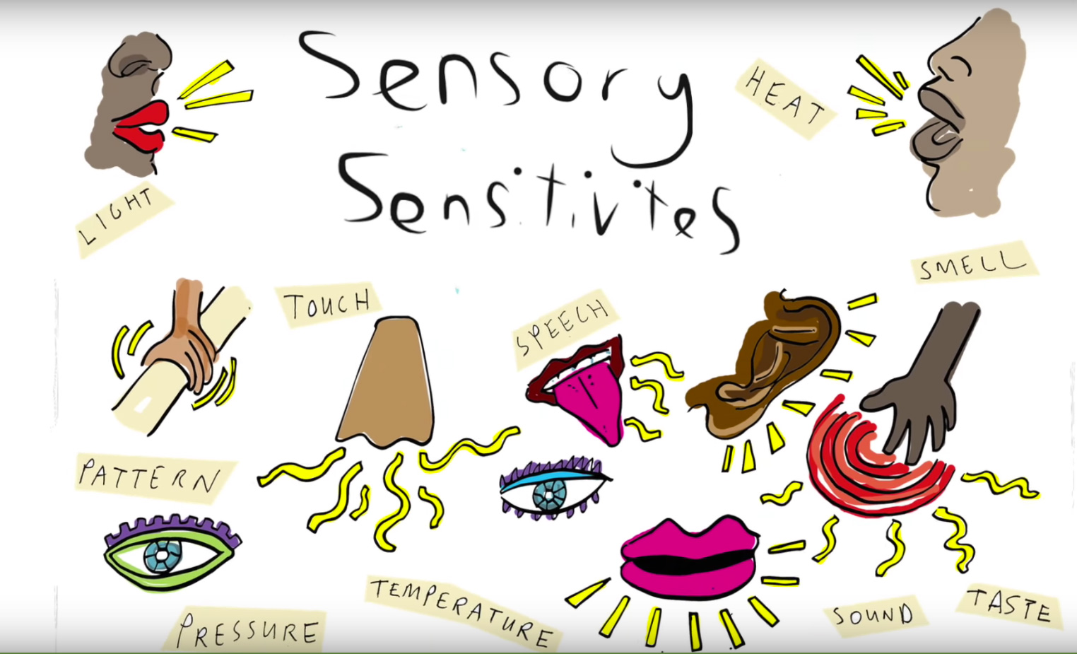
8
Notes:
The dark room might be too bright for them, they hear noise, when it’s totally quite, and Yes! They also have difficulty with distinguishing anger from happiness.

Slide 9

9

Slide 10
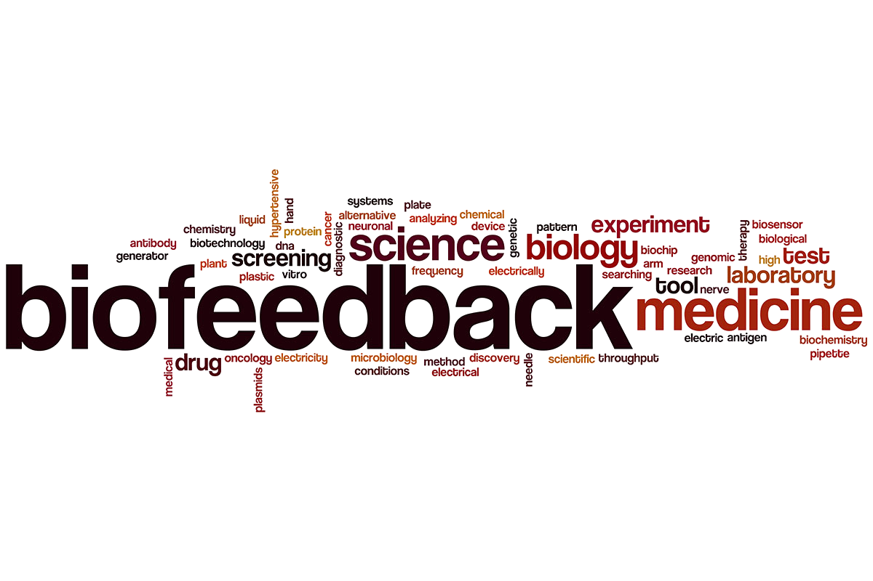
10
Notes:
Now let’s talk about detecting emotions artificially, meaning - using all kinds of sensors, cameras etc.. To understand it we need to get familiar with the concept of biofeedback. Biofeedback is basically providing people with feedback about changes in their physiological state.

Slide 11
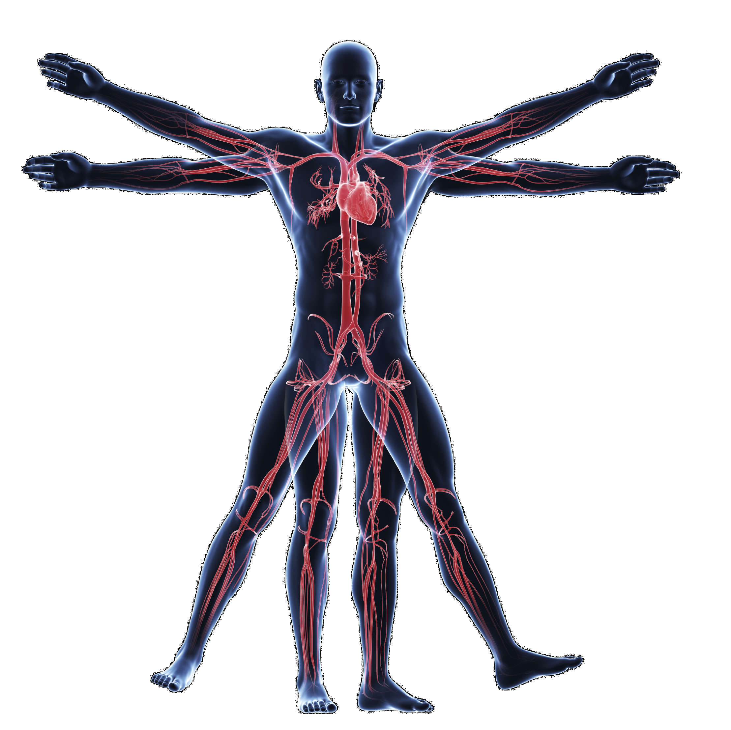
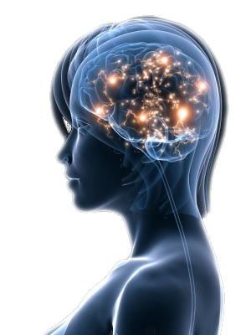
11
Notes:
Example of biofeedback may be simply skin temperature, blood pressure or heart rate. However there are also more complex bioprocesses to be detected, such as skin electrical activity, muscle action potential or electrical activity of the heart. Activation of specific brain parts during particular activities is also crucial.

Slide 12

12
Notes:
Now… how to process all that data? Here comes very popular technology nowadays called deep learning. The basic principle behind it is fairly simple and relays on how human brain operates. Look at this apple photo, and think for a moment: how do you know it is and apple?

Slide 13
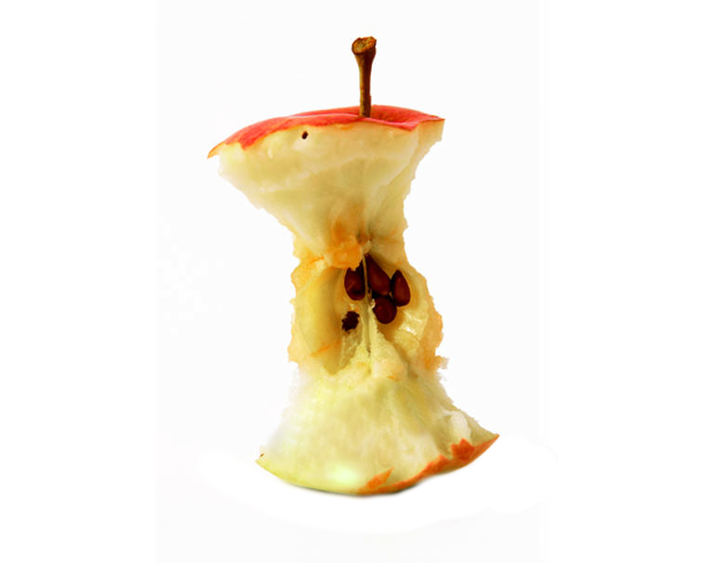

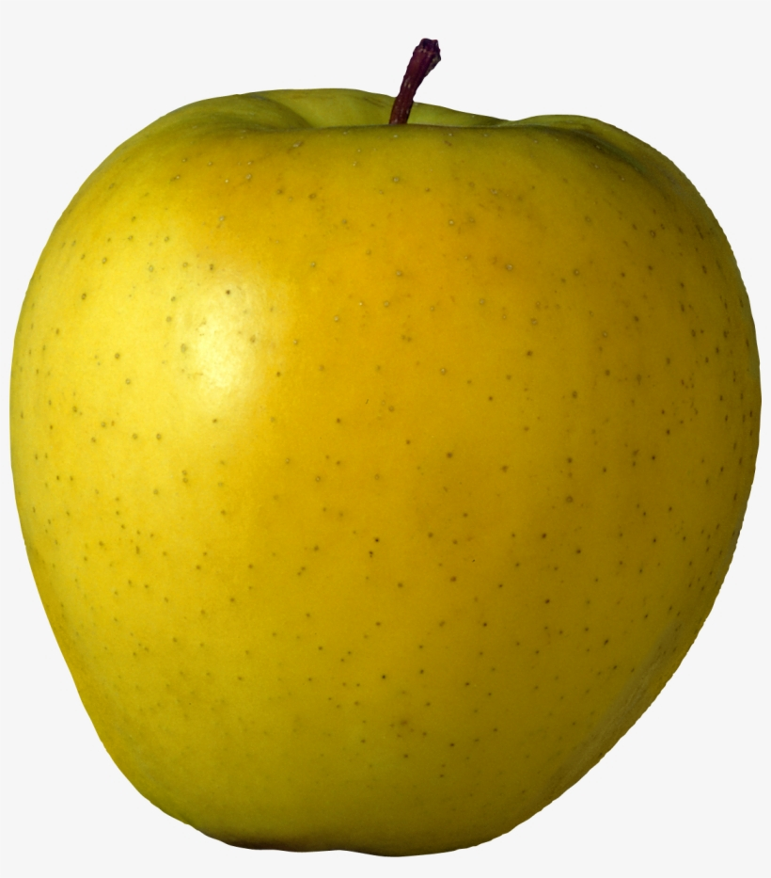
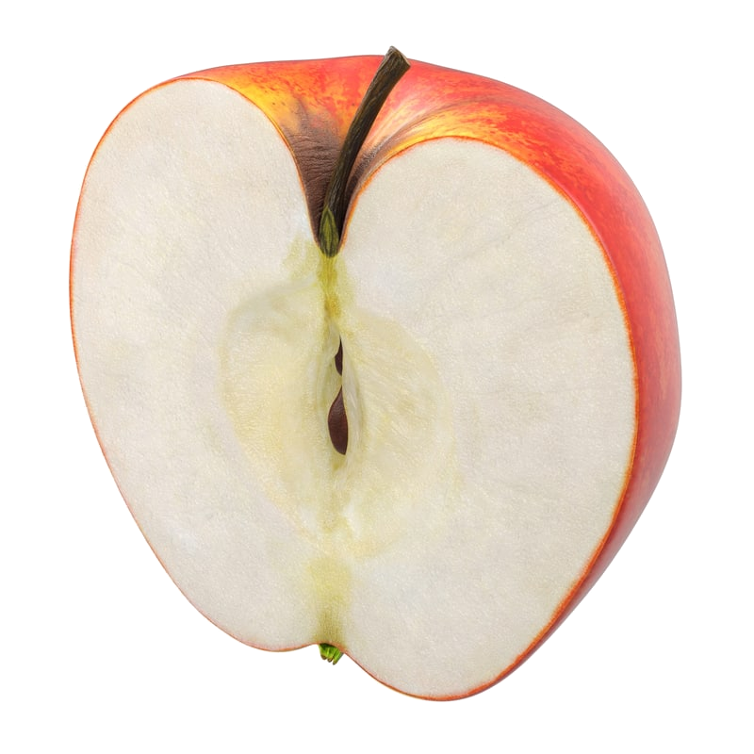





13
Notes:
The answer is simple. In your life you’ve seen thousands of similar photos. You learned that this properties that you see correspond to an apple and this is exactly how deep learning works. It sees thousands of examples of certain object or behavior, finds patterns and starts to recognize it.

Slide 14

14
Notes:
This technology, combined with various biofeedback creates great opportunities. Accurate diagnosis requires huge amount of data and thorough analysis, the more information we have, the longer it takes for a doctor to process it. Now imagine a computer analyzing patient based on hundreds of parameters in just few seconds. And the same technique may be applied to detect emotion states.

Slide 15
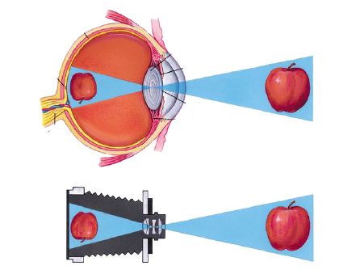
15
Notes:
But humans can only see and hear. We don’t need to measure the pressure or the heart rate.
As for devices, like smartphone or laptop, most of them also can only see and hear, due to cameras and microphones installed in them.
But if we want to use biofeedback from such devices, we will have to install the whole set of sensors, which will make the device inefficient and expensive.
+3

Slide 16
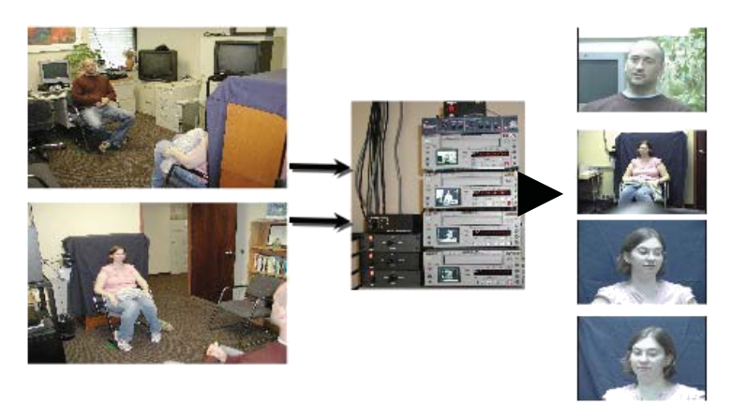
88%
16
Notes:
//That is why in our further research we were focusing on emotion recognition based only on video and audio input.
//To help us better understand the emotion recognition efficiency
Now Let me refer to an experiment held by University of Pittsburgh.
In short the experiment compared clinical diagnosis of major depression with automatically measured facial actions and vocal prosody in patients undergoing treatment for depression.
The result is astonishing, the algorithm successfully diagnosed depression with 79-88% accuracy. +10

Slide 17

17
Notes:
So, according to this data using this technique looks promising. But there are still unresolved questions we had to answear:(some issues and questions we faced during the research)
1)What is the efficiency of emotion detection ?//for mobile devices
2)Accuracy of this method and how to deal with errors?
3)How to state two emotions at the same time? Duality problem
4)Can machine perform better than a human?// in all application areas(psychology/on subjective matters)?
+-1s

Slide 18
Inaccuracy in emotion detection process, due to lack of verification methods
18
Notes:
All of this questions and issues leaded us to the problem statement, which looks like this/the following: ”Inaccuracy in emotion detection process, due to lack of verification methods.” (using unsophisticated device systems(inny jest))
After the whole research, we’ve made, we noticed, that all the methods of emotion recognition required ether many different recorders and complicated algorithms or were quite inaccurate.

Slide 19
Machine
Man power
High costs of the devices
Unqualified
Complicated in operating
Hardly ever educated in both psychology and technology
Using highly sophisticated algorithms
Inaccurate in
distinguishing specific emotions
Inaccuracy in emotion detection
Not verified
Inefficient algorithms
Based on unreliable database
Inefficient face recognition
Having high measurement error
Lack of ability of measuring gestures
Measurements
Method
19
16
Inaccuracy
of the used machines
Notes:
In order to get this statement we used ishikawa diagram, we asked ourselves “whys?”. //Out of many possible conclusions we noticed a pretty interesting one.
Which lead us to//As a conclusion the device that we always carry with us has exactly the same sensors that we humans have and this the thing we want to focus/work on. AND WE WANT TO WORK ON EMOTION DETECTING USING THEM/THOSE
//We got to the idea of combining many of methods, which we’ve presented today.

Slide 20
FACECODERS
17
Notes:
As we finally formulated our problem statement, we are ready to start our work on finding the solution to that. In fact, the research, which we have made provided us with large amount of useful informations. That should help in our work. Thank you very much for your attention.

